Slide 1
Portfolio Optimization Prediction with Machine Learning
Project 2 Group 2
Summer 2021
Group Members: Sherin Solomon, Carolina Corona, Omotara Ogundipe Sinan Colpan Vincent Wen
Notes:
Portfolio performance in time of pandemic
Some things to keep in mind for ANY Data Science project:
What have other people done already?
What worked, what didn’t?
What is your hypothesis? I.e. What are you trying to accomplish?
How will you test your hypothesis?
What do your cupcake, cake, and wedding cake versions look like?
What is your sample size? Is this enough?
What variables did you select and why?
How did you choose them?
How do you make sure that you’re choosing the least number of variables necessary yet providing the best possible performance?
Know what assumptions you’re making
Be ready to explain what you did with your nulls
Know your distributions
How can you draw confidence intervals around your results?
How do you avoid selection bias?
Be able to explain outliers
If you’re dealing with time-series:
What key metrics are you using to characterize it? (i.e. power, autocorrelation, bollinger bands, etc).
What assumptions are you making about the behaviour of the signal? (upward trending, Brownian motion, random walk)
What model will you be using? Why? What would happen if you used other models?
How do you measure model performance? How do these metrics change if your dataset is balanced or imbalanced?
How do you make sure that it’s not overfitting? How do you make sure it’s not underfitting?

Slide 2
HYPOTHESIS OF THE PROJECT
Can we use Machine Learning to see the best performing ETF amongst a cluster of Top picked ETFs across different sectors and see if Covid-19 data has any correlation with the performance of said ETFs?

Slide 3












Slide 4
DATA

Slide 5





DATA GATHERING
ETFs
Yahoo Finance APIs
60 ETFs Tickets
Across Multiple Sectors in the US
5 years data

Slide 6
DATA GATHERING
COVID-19 Policy Response Data
https://ourworldindata.org/policy-responses-covid
COVID-19 Testing Data
Contact Tracing Data
Stringency Index
Vaccination Policy
Debt Relief
Face Covering Policy
Income Support Policy
International Travel Data
Stay at Home Policy
And more ……
Criteria
Only the data based in the United States
Null Values were replaced with zero
2
3
0
4
1
5

Slide 7
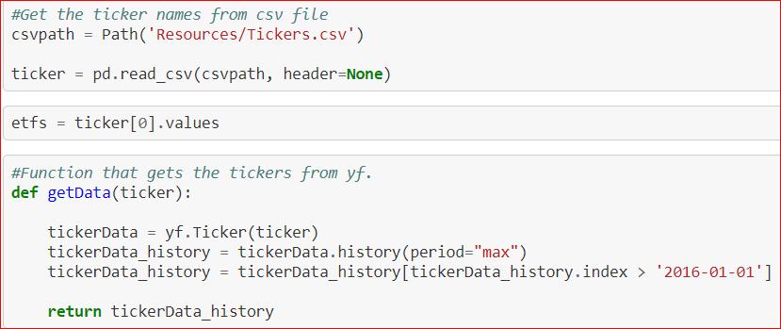

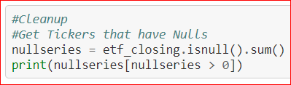
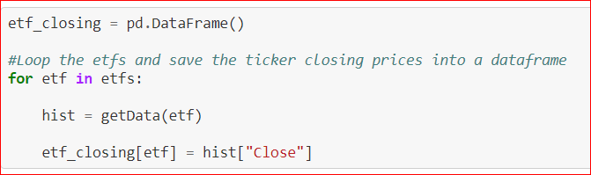
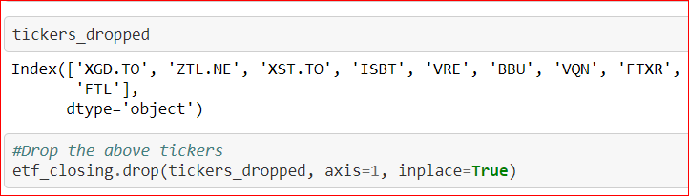
DATA PREPARATION
1
3
3
2
4
Notes:
Covid Data
Filtering the covid data to extrat the “US only
ETF
Yahoo API
60 Tickers randomly selected among different SECTORS
Go thru a loop to select the top performing ones
Only top performing 10 added to the portfolio
*** There is no trading fees considered

Slide 8
PREDICTIVE MODEL

Slide 9
PREDICTIVE MODEL
Random Forest Regression
Supervised Learning Algorithm
Notes:
Regression cause dependent variables are continuos

Slide 10
TRAINING & EVALUATING

Slide 11





ADDING THREE TRADING SIGNALS

Slide 12
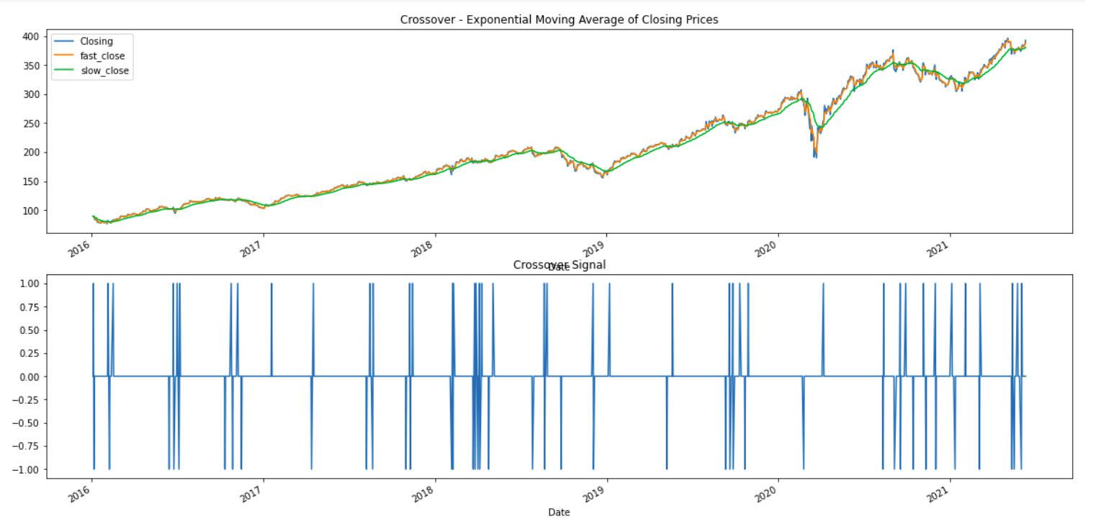
Crossover Signal

Slide 13
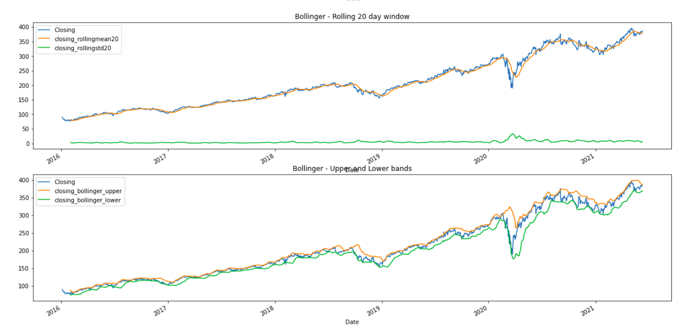
Bollinger Bands

Slide 14
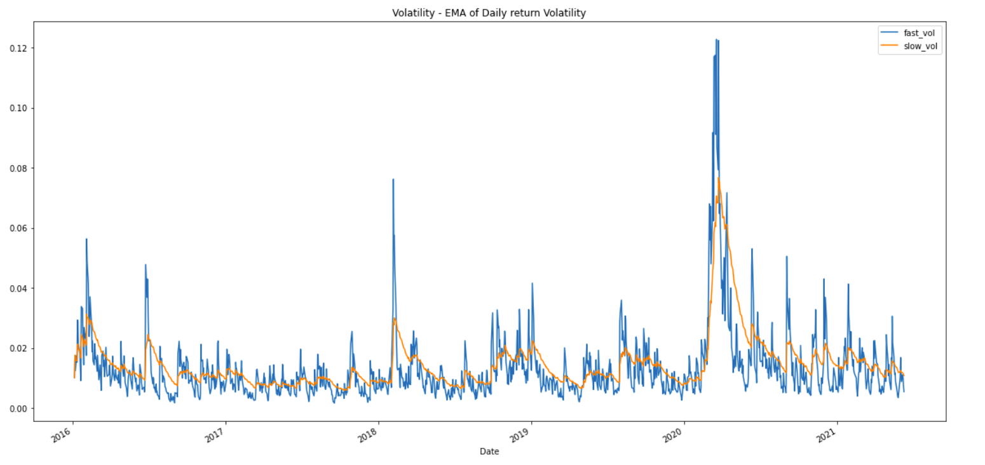
VolatilityBands

Slide 15
TUNING THE SIGNALS
CROSSOVER SIGNALS : To ensures that we have a buy or a sell signal only when there is a switch happening.
#If a buy or a sell signal doesn't change, we use 0 as hold as oppose to continuously displaying buy (1) or sell (-1)
#The crossover_toggle column is enumerated based on the values in the crossover_signal_temp column, if a signal repeats, it will increase the enumeration until the signal changes.
BOLLINGER BANDS : #Have the bands at * 2 and using rollingmean20
bollinger_df["closing_bollinger_upper"] = bollinger_df["closing_rollingmean20"] + (bollinger_df["closing_rollingstd20"] * 2)
bollinger_df["closing_bollinger_lower"] = bollinger_df["closing_rollingmean20"] - (bollinger_df["closing_rollingstd20"] * 2)

Slide 16
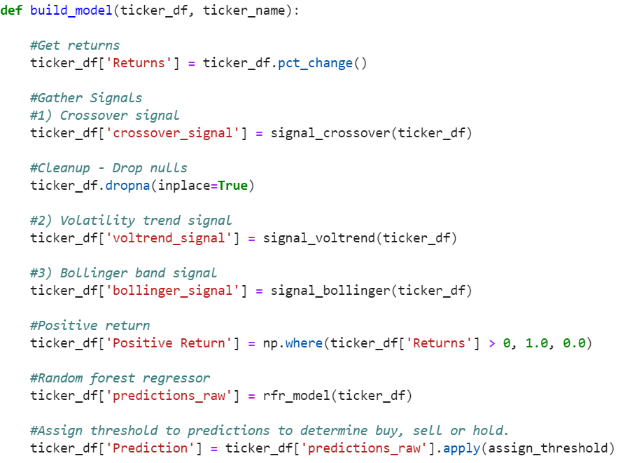
FUNCTIONS TO TRAIN THE MODEL

Slide 17
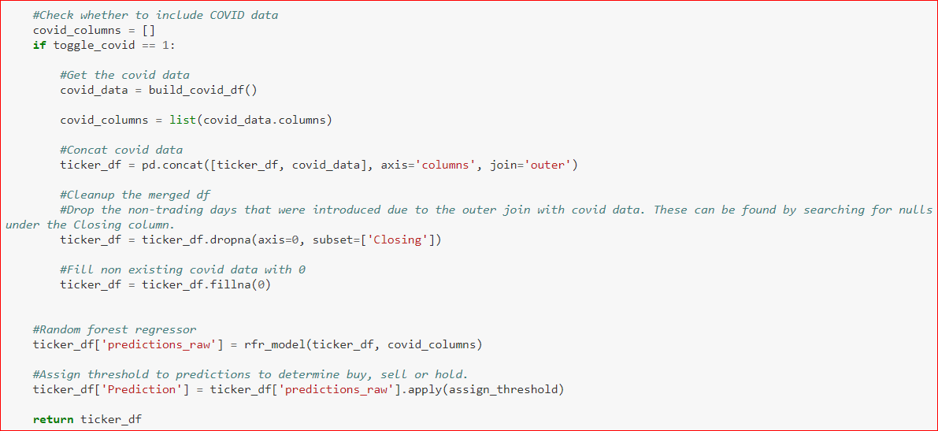
ADDING COVID DATA TO THE
PREDICTIVE MODEL

Slide 18

APPLYING ML AND RUNNING SIMULATIONS

Slide 19
APPLYING ML AND RUNNING SIMULATIONS
#def calculate_investment(predicted_df, wallet_weight)
Function that simulates buy, sell and hold actions based on prediction assuming we are investing $10,000 to the Portfolio which is our Wallet.
wallet_history = []
equity_history = []
num_stocks_history = []
#Prediction threshold determined
pred_threshold_low = 0.2
pred_threshold_high = 0.5

Slide 20
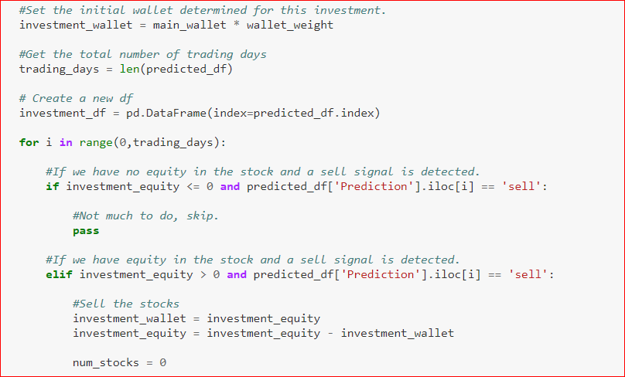
#Function that simulates buy, sell and hold actions based on prediction
Notes:
Used out features(trading signals) as the x axis and the out target (Positive return) as out

Slide 21
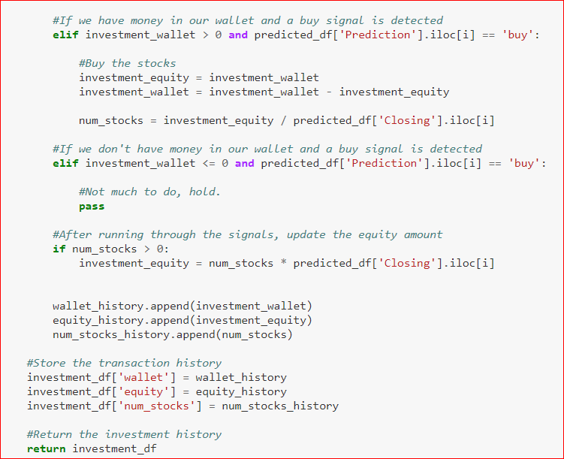
#Function that simulates buy, sell and hold actions based on prediction
Notes:
Used out features(trading signals) as the x axis and the out target (Positive return) as out

Slide 22
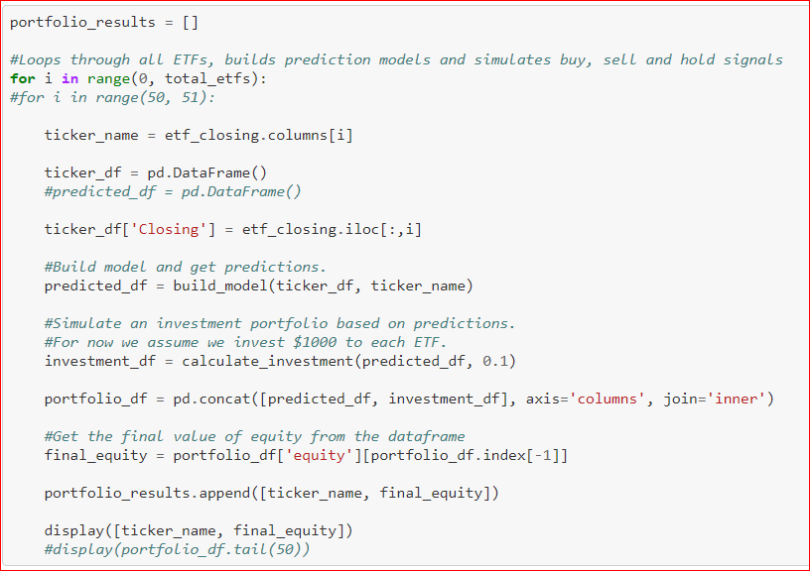
PORTFOLIO BUILDER
Notes:
Used out features(trading signals) as the x axis and the out target (Positive return) as out

Slide 23
CONCLUSION & PREDICTIONS

Slide 24
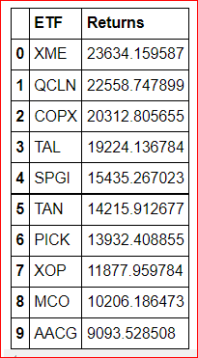
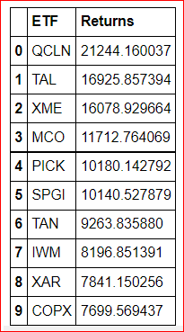
TOP 10 ETFs PERFORMANCE
WITH COVID
WITHOUT COVID
Notes:
Used out features(trading signals) as the x axis and the out target (Positive return) as out

Slide 25
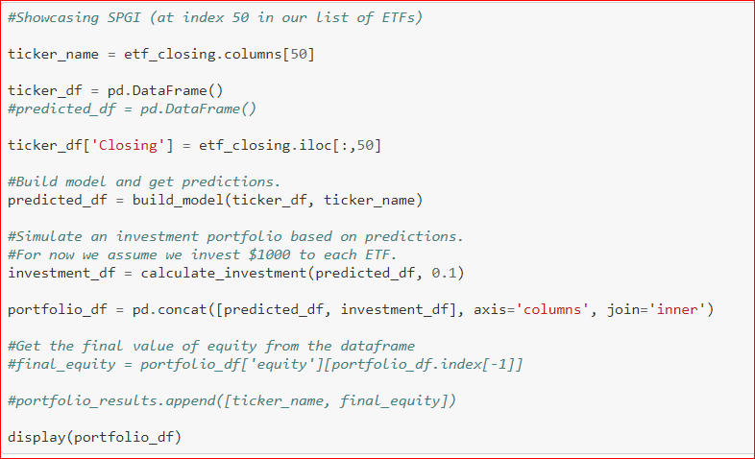
SHOWCASING SPGI
#COVID-19 data features
#Disabled = 0, Enabled = 1
toggle_covid = 1
Notes:
Used out features(trading signals) as the x axis and the out target (Positive return) as out

Slide 26
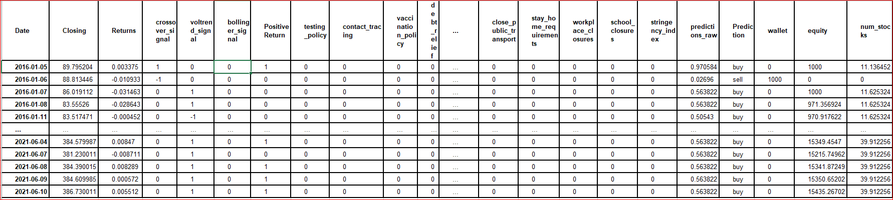
TABLE SHOWCASING SPGI WITH COVID DATA
Display(portfolio_df)
Notes:
Used out features(trading signals) as the x axis and the out target (Positive return) as out

Slide 27
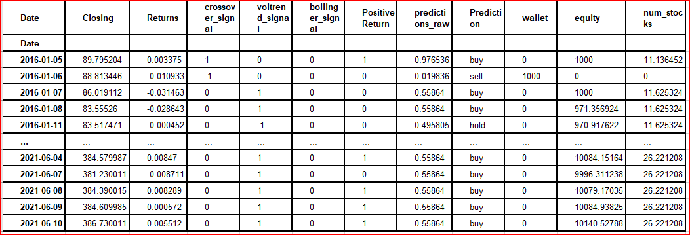
TABLE SHOWCASING SPGI WITHOUT COVID DATA
Display(portfolio_df)
Notes:
Used out features(trading signals) as the x axis and the out target (Positive return) as out

Slide 28
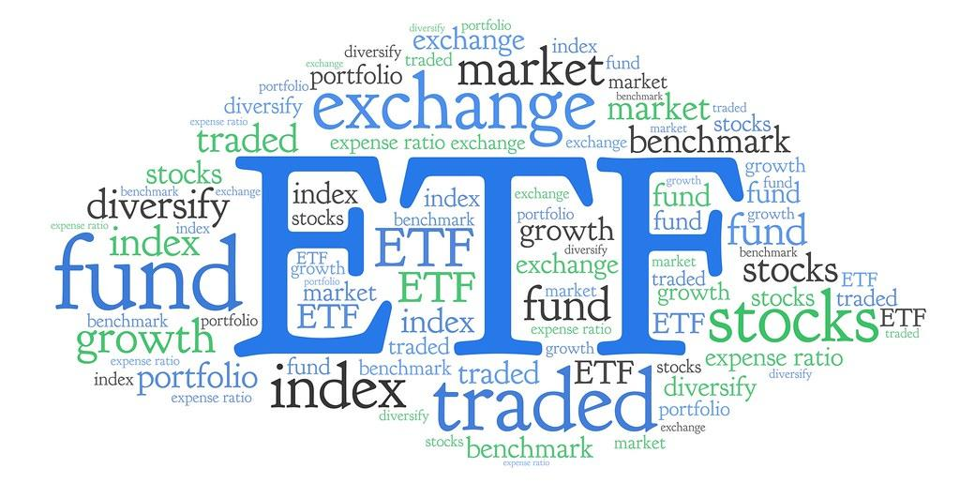
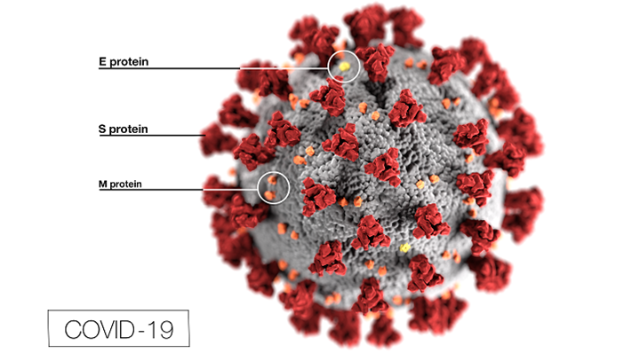
BENCHMARK RETURN
Annualized return 8%
Initial Investment of $1000
Cumulative Return of $1360.49
SPGI
Initial Investment of $1000
Cumulative Return of $10,140 without COVID Data
Cumulative Return of $15,435 with COVID Data
Notes:
Summarize your conclusions and predictions. This should include a numerical summary (what data your model yielded), as well as visualizations of that summary (plots of the final model evaluation and predictions).
WE TRIED A CLASSIFICATION MODEL BUT THAT WOULD ONLY RETURN BINARY INFORMATION BASED ON THE PERFORMANCE OF THE ETFS

Slide 29
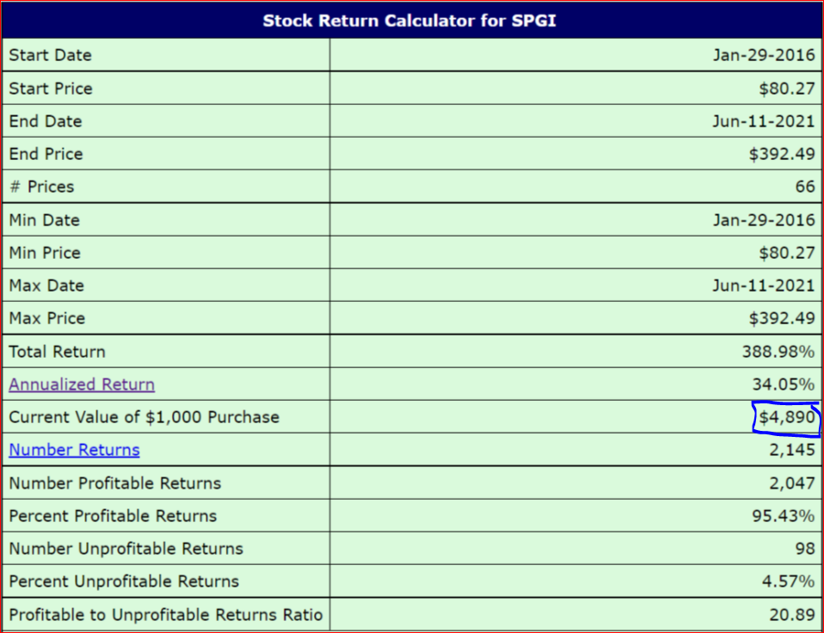
SPGI - Comparing Results
If we held our investment for 5 years $1000
$ 1000 equals $4306 as of so ours is better ($1000 / 89.8) * 386.7
89.8 being the first closing and 386.7 being the last closing
VS
Notes:
Summarize your conclusions and predictions. This should include a numerical summary (what data your model yielded), as well as visualizations of that summary (plots of the final model evaluation and predictions).
WE TRIED A CLASSIFICATION MODEL BUT THAT WOULD ONLY RETURN BINARY INFORMATION BASED ON THE PERFORMANCE OF THE ETFS

Slide 30

Project 2 Group 2
Summer 2021
Group Members: Sherin Solomon, Carolina Corona, Omotara Ogundipe Sinan Colpan Vincent Wen
Notes:
Portfolio performance in time of pandemic
Some things to keep in mind for ANY Data Science project:
What have other people done already?
What worked, what didn’t?
What is your hypothesis? I.e. What are you trying to accomplish?
How will you test your hypothesis?
What do your cupcake, cake, and wedding cake versions look like?
What is your sample size? Is this enough?
What variables did you select and why?
How did you choose them?
How do you make sure that you’re choosing the least number of variables necessary yet providing the best possible performance?
Know what assumptions you’re making
Be ready to explain what you did with your nulls
Know your distributions
How can you draw confidence intervals around your results?
How do you avoid selection bias?
Be able to explain outliers
If you’re dealing with time-series:
What key metrics are you using to characterize it? (i.e. power, autocorrelation, bollinger bands, etc).
What assumptions are you making about the behaviour of the signal? (upward trending, Brownian motion, random walk)
What model will you be using? Why? What would happen if you used other models?
How do you measure model performance? How do these metrics change if your dataset is balanced or imbalanced?
How do you make sure that it’s not overfitting? How do you make sure it’s not underfitting?

